Slide 1
Kami 3: Final
Zach Dubinsky, Jack Collins, Khai Dong

Slide 2
Overview
File Formats
Memento
New Solver Solutions
More Shapes!
GUI Refresh
Demo

Slide 3

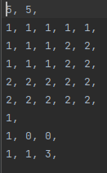

File Formats

Slide 4
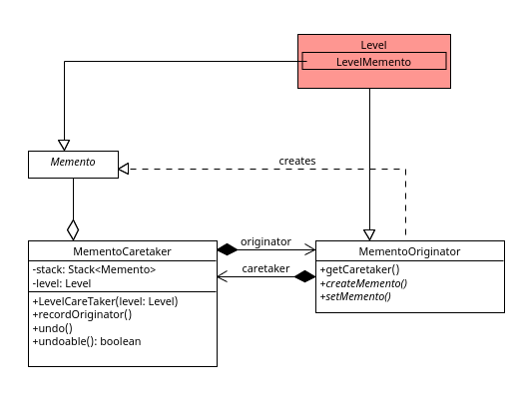
Memento

Slide 5
New Solver Solutions
Problem: Solving KAMI is NP-Hard
Solution: Release 2
User generated solutions
Command pattern
Solution: Release 3
Prove P = NP

Slide 6
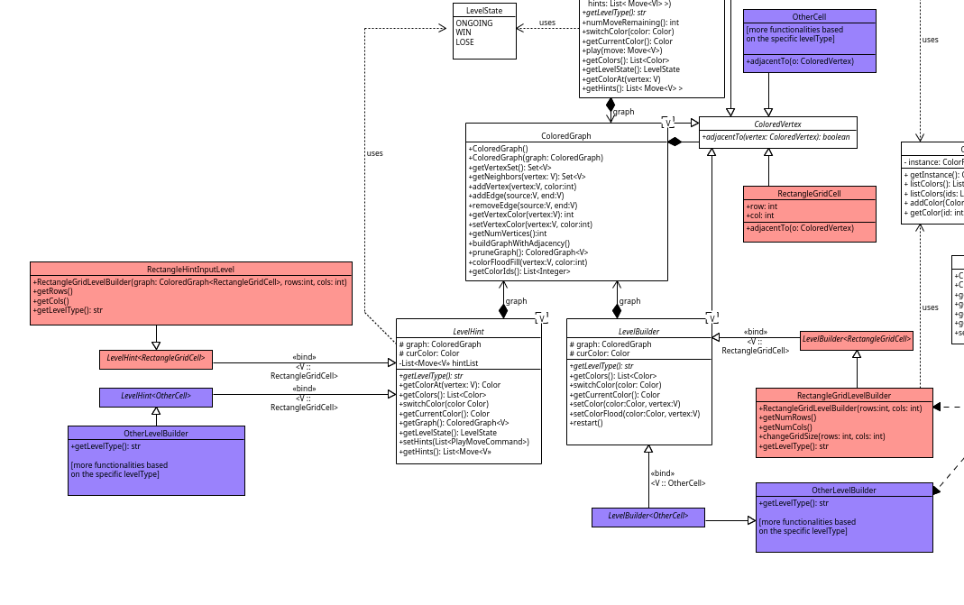

Slide 7
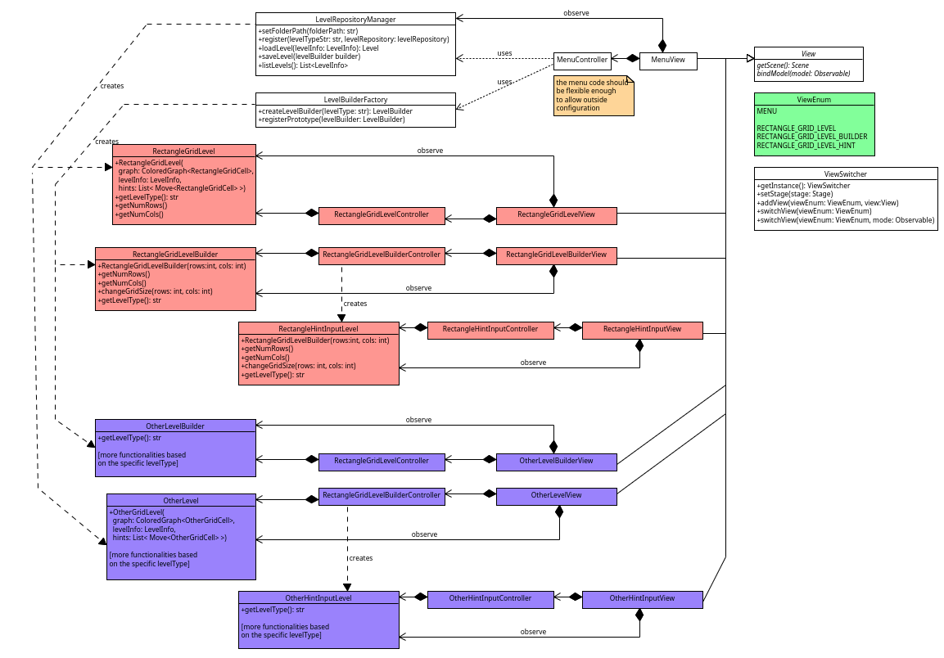

Slide 8
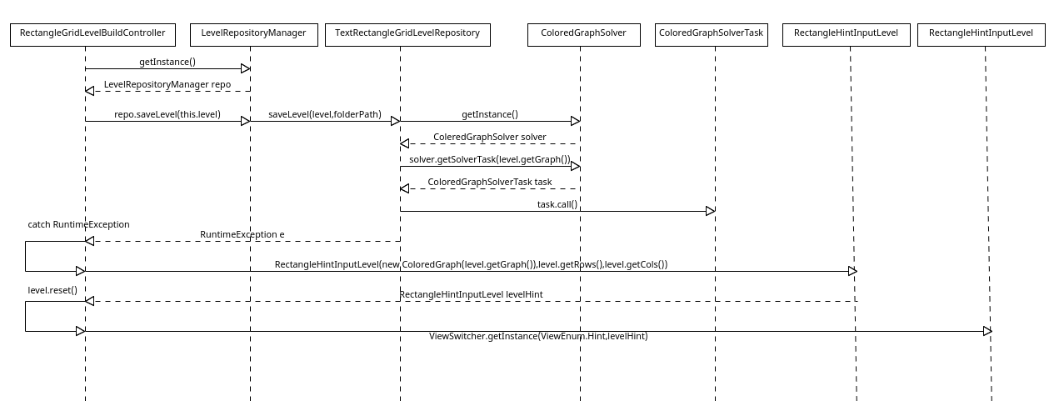
Interaction: Saver Timeout

Slide 9
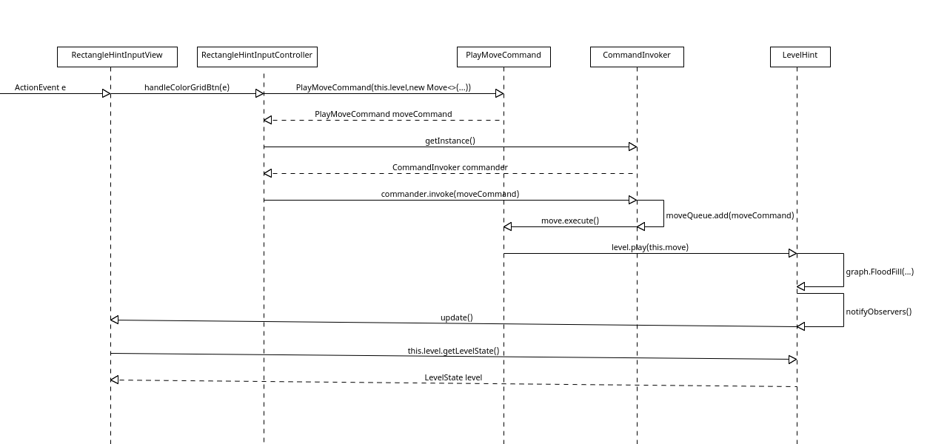
Interaction: Command

Slide 10
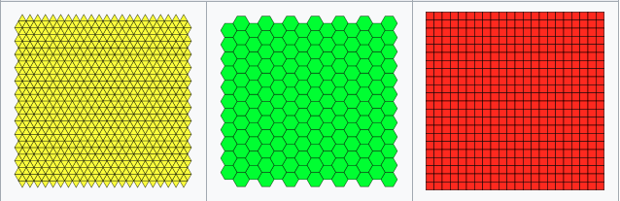
More Shapes: Euclidean Tilings
Regular Polygons
Regular Tilings
Natural row & column arrangement
Uniform shape
Only 3
Other Tilings
Natural row & column arrangement
Non-uniform shape
Many

Slide 11
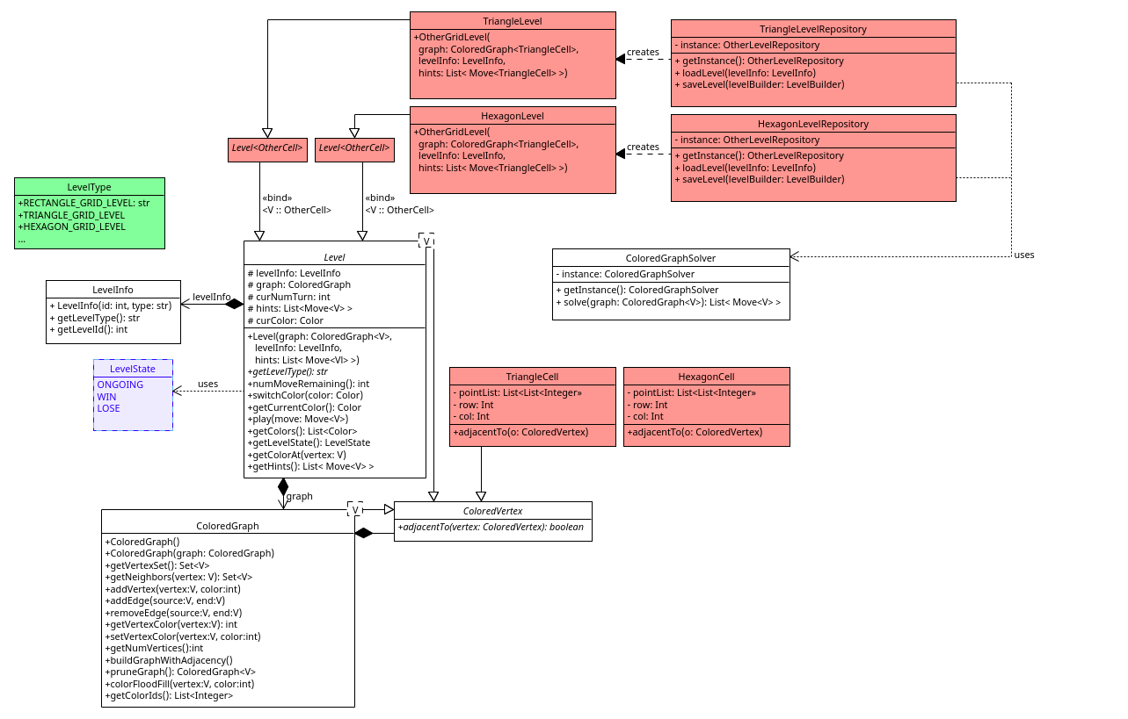
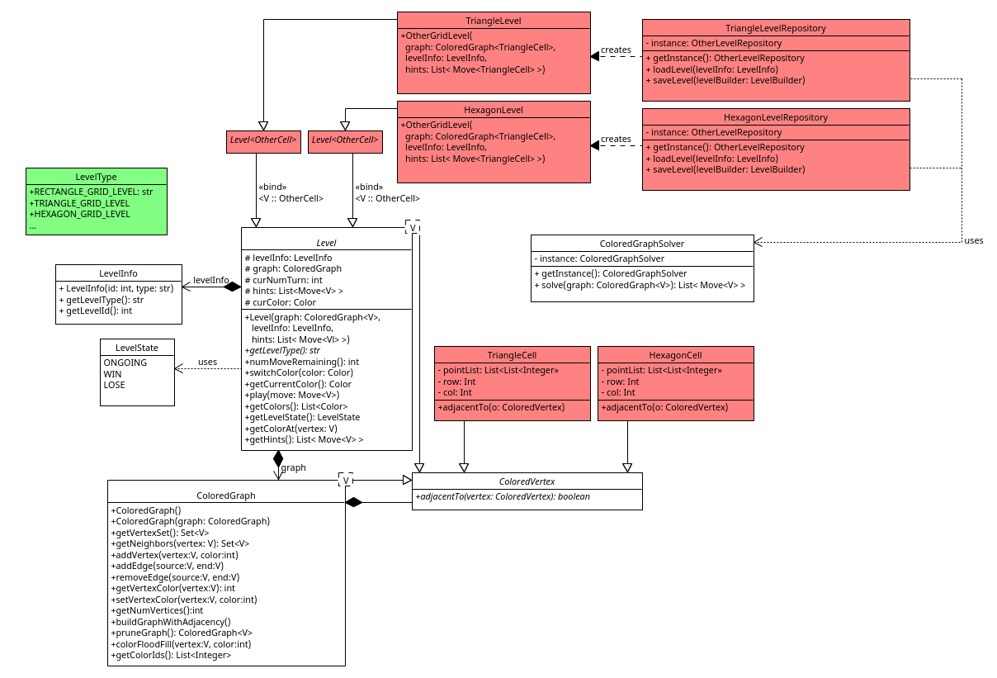

Slide 12
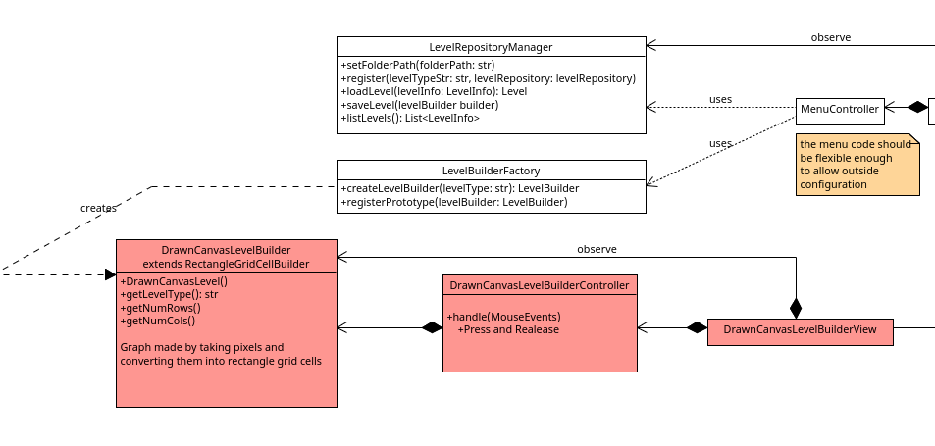
Drawing

Slide 13
GUI Refresh
Main Changes:
Control Menu on Levels for Options and Color Choices
Improvement to kami board appearance
Change of Menu Layout
Hint Descriptions —> Visual Indications

Slide 14
DEMO

